Slide 1
Domain : Aviation Project Name: Flight Delay Analysis
Weekday Vs Weekend total flights statistics
Total number of cancelled flights for JetBlue Airways on first date of every month
Week wise, State wise and City wise statistics of delay of flights with airline details
Number of airlines with No departure/arrival delay with distance covered between 2500 and 3000

Slide 2
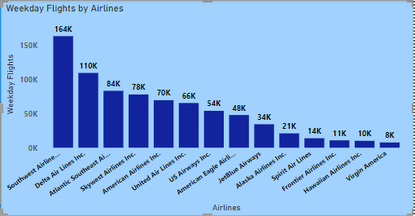
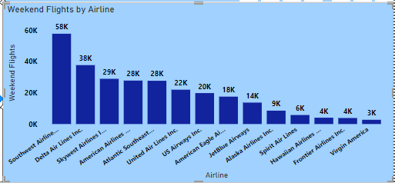
Weekday Vs Weekend total flights statistics
1) Weekday had 7,70,857 Total Flights and Weekend had 2,77,718.﻿﻿﻿﻿
2) Total Flights for Weekday (7,70,857) was higher than Weekend (2,77,718).﻿﻿
﻿﻿
﻿3) ﻿Weekday has contributed around 73.51% of Total Flights.﻿﻿
1) ﻿At 1,63,836 Southwest Airlines Co. had the highest Weekday Flights and was 2,029.95% higher than Virgin America, which had the lowest Weekday Flights at 7,692.﻿﻿
﻿
2) ﻿Southwest Airlines Co. accounted for 21.25% of Weekday Flights.﻿﻿
﻿﻿
﻿3) ﻿Across all 14 Airline, Weekday Flights ranged from 7,692 to 1,63,836.
1) ﻿At 57,750 Southwest Airlines Co. had the highest Weekend Flights and was 2,030.21% higher than Virgin America, which had the lowest Weekend Flights at 2,711.﻿﻿
﻿﻿
2) ﻿﻿Southwest Airlines Co. accounted for 20.79% of Weekend Flights.﻿﻿
﻿﻿
3) ﻿﻿Across all 14 Airlines, Weekend Flights ranged from 2,711 to 57,750.

Slide 3
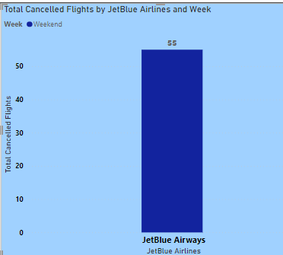
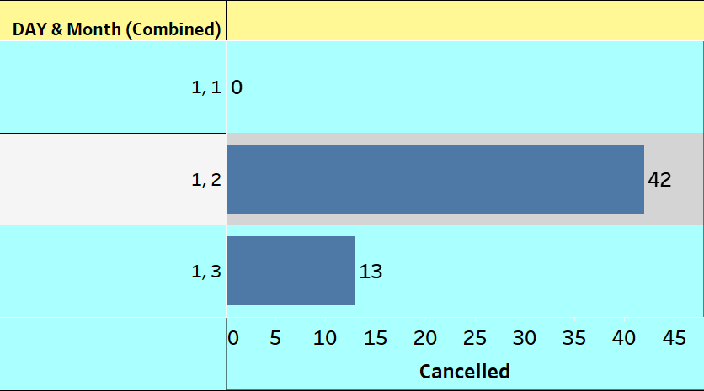
Total number of cancelled flights for JetBlue Airways on first date of every month
Total flights cancelled by JetBlue Airways are 55.
2) If we observe flights cancelled are in only weekends in 2nd and 3rd month.
3) In the 2nd month the cancelled flights are around 76% which are considered to be the highest cancelled flights than the 3rd month which is 24%.

Slide 4
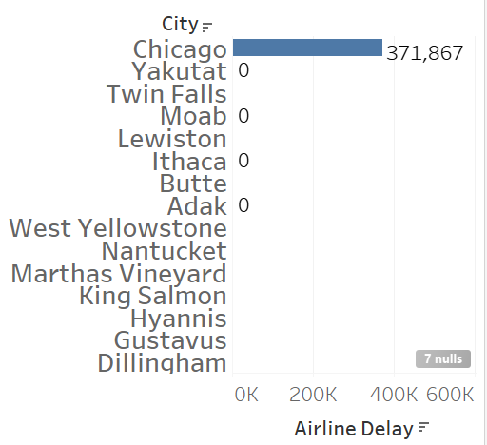
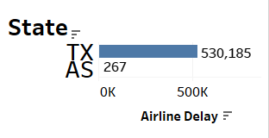
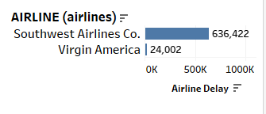
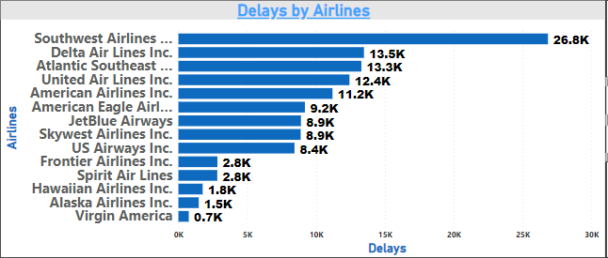
Week wise, State wise and City wise statistics of delay of flights with airline details
***WEEK WISE Details***
In week 11 - Virgin america has least delays i.e 247 And In week 10 - Delta airlines Inc. has most delays i.e 92056
***CITY WISE Details***
Chicago city has max delays – 371867
Below Mention cities has no delay in flights
***STATE WISE Details***
Tx state has maximum delays – 530185
AS state has minimum flights delays – 267
***Airlines Wise Details***
Virgin america has less delays i.e 24002 Southwest airlines has max delays i.e 636422
1) At 26,838 Southwest Airlines Co. had the highest Delays and was 3,483 Which is 18% higher than Virgin America, which had the lowest Delays at 749.﻿﻿
﻿﻿
﻿﻿2) Southwest Airlines Co. accounted for 21.96% of Delays.﻿﻿
﻿﻿
3) ﻿﻿Across all 14 Airlines, Delays ranged from 749 to 26,838.﻿﻿
Conclusion-
1. Spirit airlines delayed the most due to airline delay and Southwest Airlines co. cancelled the most due to bad weather.
2. Mostly all airlines got cancelled due to bad weather.
3. According to the state, on an average max. delays were in Delaware(DE) because it is a small regional airport.

Slide 5
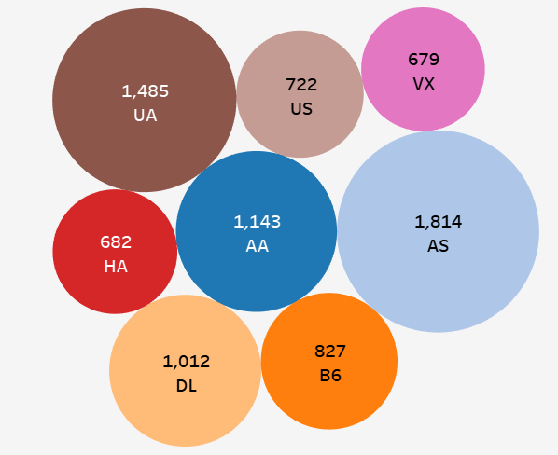
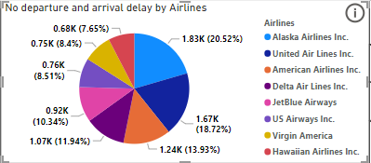
Number of airlines with No departure/arrival delay with distance covered between 2500 and 3000
1) Alaska Airlines Inc. stands in the first place with no departure and arrival delays which contributes 20.52% of total flights.
2) Hawaiian Airlines Inc. has the highest departure and arrival delays which contributes around 7.65% out of total flights.
3) Total Flights with No departure and arrival delays are 8920.

Slide 6
Conclusion
1) Weekday had 7,70,857 Total Flights and Weekend had 2,77,718.﻿﻿﻿﻿
Total flights cancelled by JetBlue Airways are 55.
According to the 3rd KPI, Southwest Airlines Co. had the highest Delays and was
3,483.18% higher than Virgin America, which had the lowest Delays at 749.﻿﻿
﻿﻿Most common reason for Airline delay is bad weather.
4) There are total of 8 airlines with No departure/arrival delay with distance
covered between 2500 and 3000. Alaska Airlines Inc. stands in the first place with no
departure and arrival delays which contributes 20.52% of total flights.

